Slide 1
DBMS SQL
Lesson 2: Basics of SQL

Slide 2

Lesson Objectives
To understand the following topics:
  SQL, rules for SQL Statements, standard SQL Statement groups
  SQL*PLUS & iSQLPlus environment

Slide 3
2.1: SQL
What is SQL?
SQL:
  SQL stands for Structured Query Language.
  SQL is used to communicate with a database.
  Statements are used to perform tasks such as update data on a database, or retrieve data from a database.
  Benefits of SQL are:
    It is a Non-Procedural Language.
    It is a language for all users.
    It is a unified language.
Notes:
What is SQL?
SQL stands for Structured Query Language. Pronounced as SEQUEL, SQL was
originally developed by IBM based on Dr. E.F. Codd’s relational model to
define, manipulate and control data in a database
SQL is a set of commands that allows you to access a Relational Database.
SQL is an ANSI standard computer language.
SQL can execute queries against a database.
SQL can retrieve data from a database.
SQL can insert new records in a database.
SQL can delete records from a database.
SQL can update records in a database.
SQL is easy to learn.
SQL is a non-procedural, English-like language that processes data in “groups of records” rather than processing one record at a time.
SQL provides automatic navigation to the data.

Slide 4
What can SQL do?
SQL
  allows you to access a database.
  can execute queries against a database.
  can retrieve data from a database.
  can insert new records into a database.
  can delete records from a database.
  can update records in a database.
Notes:
Almost all modern Relational Database Management Systems like MS SQL Server, Microsoft Access, MSDE, Oracle, DB2, Sybase, MySQL, Postgres, and Informix use SQL as standard database language.
However, although all those RDBMS use SQL, they use different SQL dialects
For example: MS SQL Server specific version of the SQL is called T-SQL, Oracle version of SQL is called PL/SQL which also supports Procedural Language features, MS Access version of SQL is called JET SQL, etc.
Oracle has further modified SQL to support ORDBMS features.

Slide 5
2.1: SQL
Rules for SQL statements
Rules for SQL statements:
  SQL keywords are not case sensitive. However, normally all commands (SELECT, UPDATE, etc) are upper-cased.
  “Variable” and “parameter” names are displayed as lower-case.
  New-line characters are ignored in SQL.
  Many DBMS systems terminate SQL statements with a semi-colon character.
  “Character strings” and “date values” are enclosed in single quotation marks while using them in WHERE clause or otherwise.
Notes:
Add the notes here.

Slide 6
2.1: SQL
Standard SQL statement groups
Given below are the standard SQL statement groups:
Groups | Statements | Description
DQL | SELECT | DATA QUERY LANGUAGE – It is used to get data from the database and impose ordering upon it.
DML | DELETE INSERT UPDATE MERGE | DATA MANIPULATION LANGUAGE – It is used to change database data.
DDL | DROP TRUNCATE CREATE ALTER | DATA DEFINITION LANGUAGE – It is used to manipulate database structures and definitions.
TCL | COMMIT ROLLBACK SAVEPOINT | TCL statements are used to manage the transactions.
DCL (Rights) | REVOKE GRANT | They are used to remove and provide access rights to database objects.
Notes:
Standard SQL Statement groups:
“SQL commands” are “instructions” used to communicate with the database to perform “specific tasks” that work with data.
A database is a collection of structures with appropriately defined authorizations and accesses. The tables, indexes are structures in the database and are called as “objects” in the database.
The names of tables, indexes, and those of columns are called “identifiers”.
SQL commands can be used not only for searching the database, but also to perform various other functions.
For example: You can create tables, add data to tables, or modify data, drop the table, set permissions for users, etc.

Slide 7
Notes:
Standard SQL Statement groups:
“SQL commands” are “instructions” used to communicate with the database to perform “specific tasks” that work with data.
A database is a collection of structures with appropriately defined authorizations and accesses. The tables, indexes are structures in the database and are called as “objects” in the database.
The names of tables, indexes, and those of columns are called “identifiers”.
SQL commands can be used not only for searching the database, but also to perform various other functions.
For example: You can create tables, add data to tables, or modify data, drop the table, set permissions for users, etc.

Slide 8
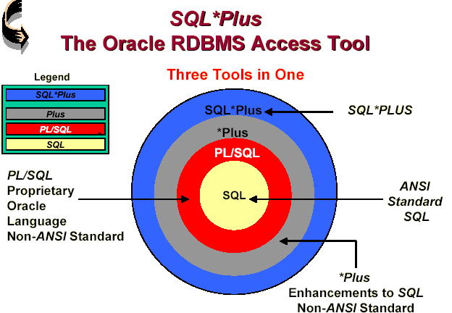
2.2: SQL * Plus & iSQLPlus Environment
SQL* Plus Tool
Notes:
SQL*PLUS:
SQL* PLUS is an Oracle tool which accepts SQL, and SQLPLUS commands and PL/SQL blocks, and executes them.SQL*Plus commands can be abbreviated

Slide 9
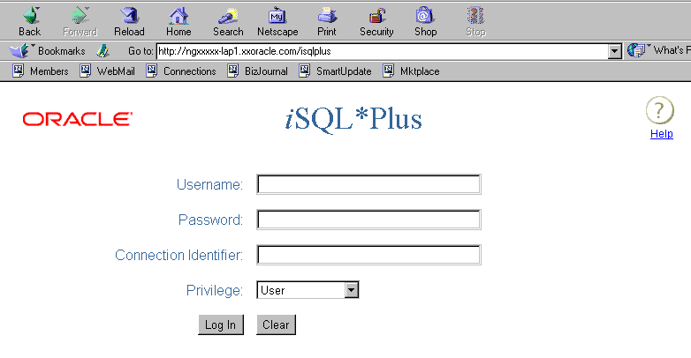
2.2: SQL * Plus & iSQLPlus Environment
Logging to Oracle Server using iSQLPlus
To log into the iSQL*Plus environment:
  In the Windows browser, type the URL in the address field. The user will be directed to iSQL*Plus environment screen.
Notes:
Oracle provides a browser based facility also to access SQL* Plus i.e iSQLPlus. Unlike SQL*Plus the commands in iSQLPlus cannot be abbreviated. Both SQL*Plus and iSQLPLus are Oracle proprietary interfaces.
How to access SQL* PLUS ?
Get your Oracle user name and password, and connect string from your DBA or Instructor.
As shown on the slide you get the login screen wherein the required details can be put in to login into Oracle

Slide 10
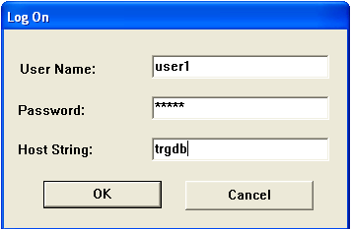
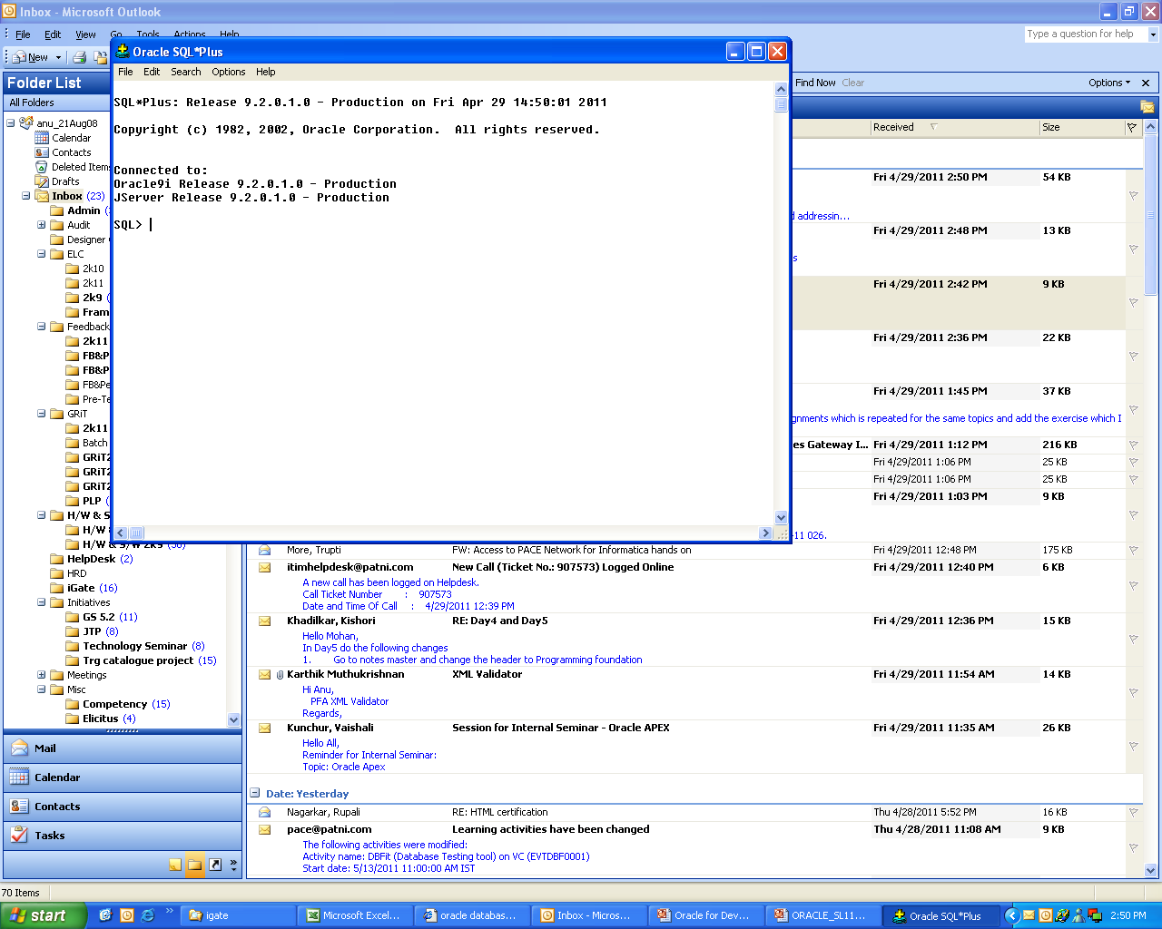
2.2: SQL * Plus & iSQLPlus Environment
Logging to Oracle Server using iSQLPlus
To connect to the Oracle server:
  Select Start, go to Programs, and select Oracle-OraHome8I.
  Go to Application Development, and select SQL Plus. You will get the following logon screen:
Connect to SQL*Plus
Notes:
Similarly you can use the username, password and Host String details to use the SQL * Plus tool. This is a GUI based tool to interact with Oracle
To enter a SQL> command, type the command at the SQL > prompt. An SQL command can be continuously entered on a single line, or it can be spread over multiple lines. In case of any typing error, use BACKSPACE or DEL key to erase, and then continue typing.
SQL> SELECT empno,hiredate FROM emp WHERE hiredate >
'01-jan-82' ;
The command can also be entered as:
SQL>SELECT empno,hiredate
FROM emp
WHERE hiredate >'01-jan-82';

Slide 11

Summary
In this lesson, you have learnt:
  What is SQL?
    Rules for SQL statements
    Standard SQL statement groups
  SQL*PLUS environment

Slide 12

Review Question
Question 1: SQL ___.
  Option 1: cannot execute queries against a database.
  Option 2: can manipulate data from a database.
  Option 3: cannot retrieve data from a database.
  Option 4: can insert new records in a database.
  Option 5: can delete records from a database.

Slide 13
Review Question
Question 2: SQL categories are ___.
  Option 1: DDL
  Option 2: DML
  Option 3: DSL
  Option 4: DQL
  Option 5: TCL
  Option 6: TDL

